Slide 1

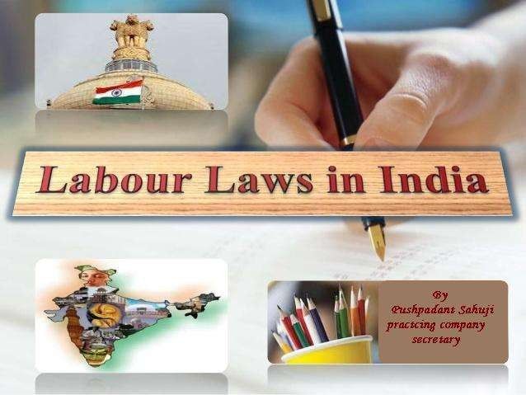




Slide 2


What’s Labour Laws?
Labour law or employment law is the laws, regulations, administrative rulings,
body of
and
precedents which address the legal rights of, and
restrictions on, labourers and their organizations.
It deals with many aspects of relationship between trade unions, employers and their employees.
The final goal of Labour laws is to reduce the differences between the Employer and Employee which leads in Industrial Growth and Growth of a Nation.

Slide 3

Need for Labour Laws Compliance
To enable every one to be more conversant about Labour Laws and take more and more benefits of these laws.
reduce disputes between employer and employees or good employer – employee relations.
To reduce child labour and encouragement of
education.
their
To create Just and Equitable society.

Slide 4


Overview of Labour Laws in India
Under the Constitution of India, Labour is a subject in the Concurrent List where both the Central and State Governments are competent to enact legislation.
As per the Constitution of India, matters in labour law contained in Concurrent List are:
Entry No. 22: Trade Unions, industrialists and labour
disputes.
Entry No. 23: Social Security and insurance, employment and unemployment
Entry No. 24: Welfare of labour

Slide 5

Subjects restricted to Union List are:
Entry No. 55: Regulation of labour and safety in mines and oil fields.
Entry No. 61: Industrial disputes concerning Union employees.
Entry No. 65: Union agencies and institutions for
Vocational training.

Slide 6

Acts which govern the Labour Laws
Laws related to Industrial Relations:
1. The Trade Unions Act, 1926
The Industrial Employment (Standing Act, 1946
The Industrial Disputes Act, 1947.
Orders)
Laws related to Equality and Empowerment of Women:
The Maternity Benefit Act, 1961
The Equal Remuneration Act, 1976.

Slide 7

Laws related to Wages:
1. | Workmen’s Compensation Act, 1923
2. | The Payment of Wages Act, 1948
3. | The Working Journalist (Fixation Wages) Act, 1958 | of | Rates | of
4. | The Payment of Bonus Act, 1965.
➢ | Laws related to Working Conditions:
1. | The Factories Act, 1945
The Contract Labour (Regulation & Abolition) Act, 1970
Shops and Establishment Act
Indian Boilers Act, 1923
The Dangerous Machines (Regulations) Act, 1983.

Slide 8
Laws related to Social Security:
The Employees’ State Insurance Act, 1948
The Employees’ Provident Fund & Miscellaneous Provisions Act, 1952
The Payment of Gratuity Act, 1972
The Unorganized Workers’ Social Security Act, 2008
Employers’ Liability Act, 1938
The Children (Pledging of Labour) Act, 1938
The Child Labour (Prohibition and Regulation) Act, 1986
The Bonded Labour System (Abolition) Act, 1976
The Employment of Manual Scavengers and
Construction of Dry Latrines Prohibition Act, 1993.

Slide 9



Role of Company Secretary in Compliance of Labour Laws
Company Secretaries as Principal Officers are responsible for all legal compliances have a crucial role in Labour Law compliances.
The extensive educational background, knowledge and training that a Company Secretary acquires, especially on legal compliances makes him a versatile professional.
He is associated with the
planning of various of general
process, judgment and
compliance laws, financial matters, administration
meeting and administration of tax laws.

Slide 10
The report prepared by a Practicing Company Secretary may be annexed with the Board’s report to apprise the shareholders and be used as a document for all purposes.
A Practicing Company Secretary, apart from acting as conscious keeper of the company advises on good governance practices and compliance of various laws like Corporate Governance norms as prescribed under The Companies Act, 1956, Listing Agreement with Stock Exchanges and compliance of various labour laws.

Slide 11


Conclusion
The rapid pace of technological innovation and the constantly changing global business landscape has fuelled the need for good corporate governance.
Business enterprises employing personnel, both in the executive cadre and also those categorized as workers in the context of labour are required to be fully aware of and comply with the legal obligations to ensure good governance.
The company can prosper in the long run only when the various stakeholders of a corporate are satisfied and happy.

Slide 12



